Slide 1
First cycle graduation thesis
Theme
Mobile application of CARPOLLING (covoiturage)
Realised by :
- Benarous Ahmed Omar Farouq
- Mahmoudi Riyadh
Advisors: Juries:
Mr.Kadri Wallid -M.Sayeh Amine
Mr.Reguieg Seddik -M.Hadj Henni Mhamed
College year: 2017/2018

Slide 2
Presentation plan
Project preliminary study
Application conception
Implementation
Used tools

Slide 3

EDiNi mAak
Your new mobile platform for carpooling in Algeria

Slide 4
Project preliminary study
Introduction
OBJECTIVES
CONSTRAINS
SOLUTIONS
Standards for choosen solutions
Main concept of the application

Slide 5
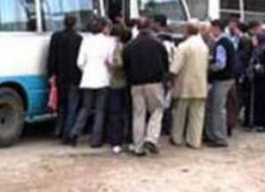
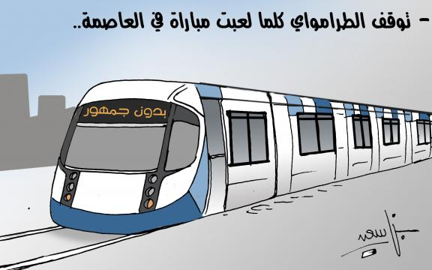

Introduction
Introduction
Many of public transports lines are out of services after 6pm
delay and the lack of any comfort and discipline services
prices of public transports are raising
As a solution we would like to invest in one of the ideas that had a lot of success and
appreciation around the world, and integrate it in the Algerian society to make it one of the
common traveling ways beside public transports
It’s “Carpooling”

Slide 6
OBJECTIVES
Introduction
Objectives
Choosing the right and the most useful devise to support our app
Integrate a strategy to insure confidentiality and trust
A simple functional design
Secure users data

Slide 7
CONSTRAINS
Introduction
Objectives
Constrains
Find a compatible strategy with the Algerians mentality to insure application user’s ecurity and trust
Insure portability and availability of our application
Designing the application in a simple way to make it useful and easier manipulated
Find a secure database server to insure user’s data security
Find alternative solution for payment methods instead of credit cards.

Slide 8
SOLUTIONS
Introduction
Objectives
Constrains
Solutions
carpooling application in a form of social network to provide security and trust for users
A mobile application for smart phones, based on android .
The fact of confidentiality and trust in our application is based on user’s choices
Use Firebase database
Payment method is in cash

Slide 9

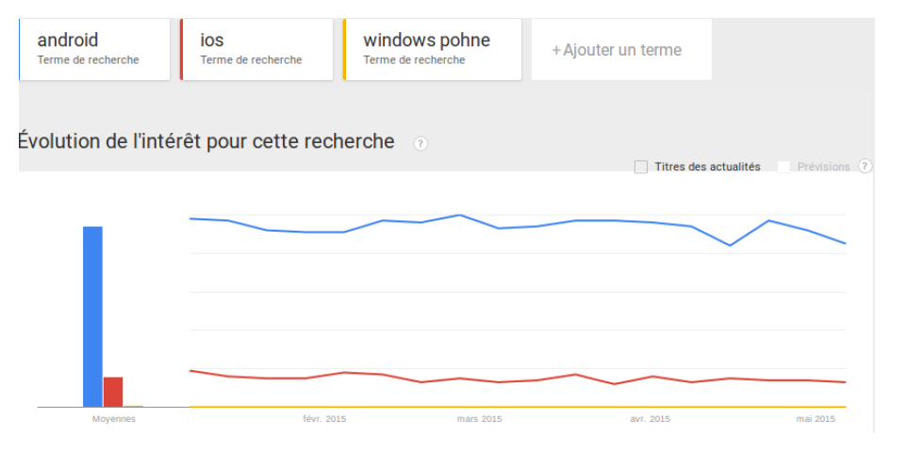
Standards for choosen solutions
Standards
Android mobile application
Why Android operating system ?
In Alegria, most of citizens uses Android! According to a small statistic study realised by Android-dz team.
The most researched words in 2015 are from operating systems signed by
Google: which means Android.
Statistics by Android-dz team

Slide 10
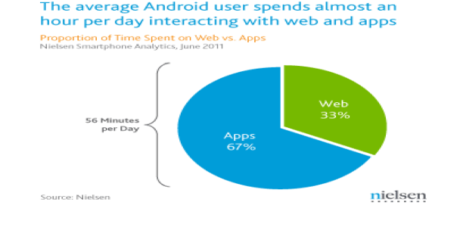
Standards
Why a mobile application ?
we can notice as shown in statistics that android users are mostly
using apps more than web in general.
Based on those statistics we have choosed a native mobile app instead of web app to isure portability and the availability of our platform for our users.

Slide 11

Standards
Why social network features ?
It’s a useful solution, and the most appropriate one for our society.
The feature of social network allow users to create their own
community, by adding friends and people they know to a custom friend list. Therefore, they can accept and send friend requests, and delete people from friends list, which makes sharing cars and trips information more confidential and trusted between users.

Slide 12
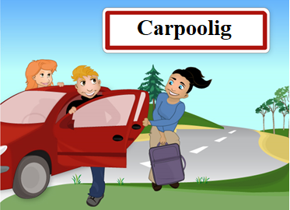

Main concept of the application
Standards
Main concept
CARPOOLING SOCIAL NETWORK APP
It is a carpooling application in a form of social network, it allows users share their trips and
cars with their friends and acquaintances also strangers, anywhere and anytime free of charge
or with payment. With the possibility of text messaging communications with them which
provides a real-time communication and travelling information share between users.

Slide 13
Application conception
Application fonctionalities
Manipulating trips and friends

Slide 14
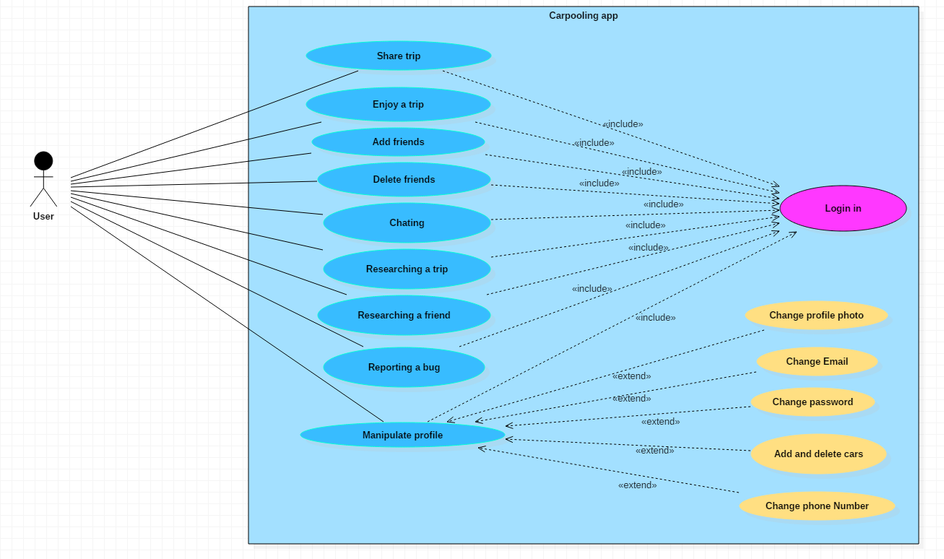
Application fonctionalities
APP fonctionalities
User Actions

Slide 15
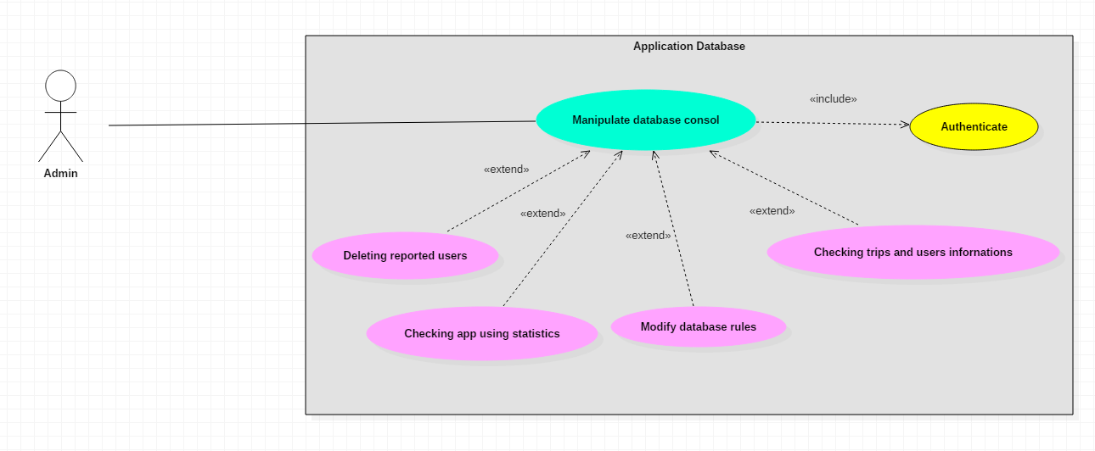
APP fonctionalities
Admin Actions

Slide 16
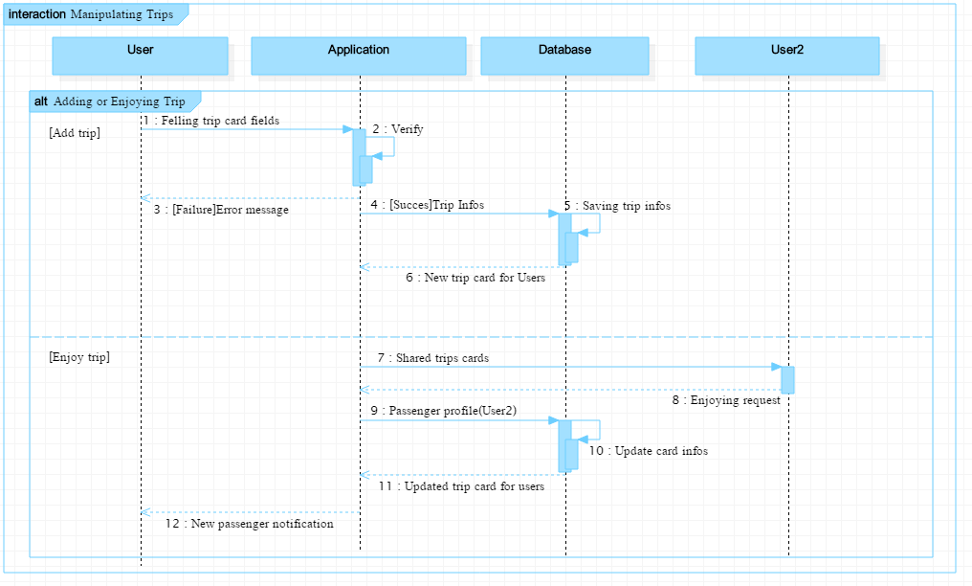
Manipulating trips and friends
APP fonctionalities
Manipulating trips & friends
Manipulating Trips

Slide 17
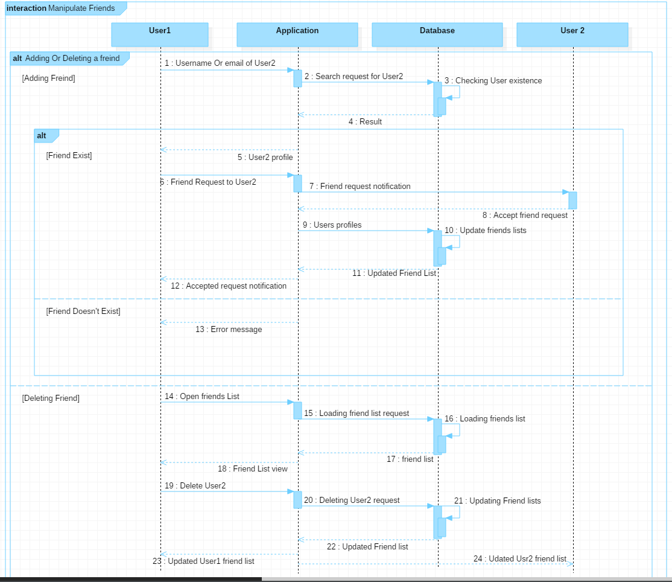
APP fonctionalities
Manipulating trips & friends
Manipulating Friends

Slide 18
Implementation
security and coherence methods
User interface

Slide 19
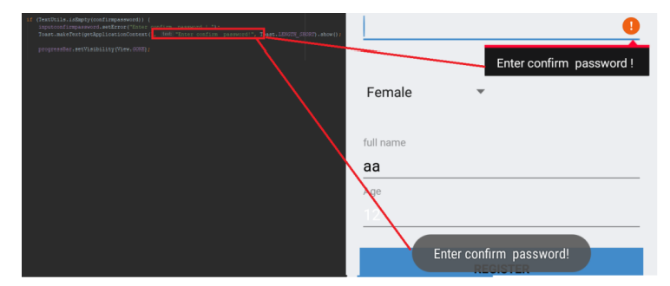
security and coherence methods
security & coherence
Coherence methods:
Users are guided by hints and spinners (choice list) while filling fields of information in addition a backend syntax verification systems displaying alerts and error messages in the
fields containing wrong or invalid format of information in order to reduce the possibility of
storing those wrong information provided by users.

Slide 20
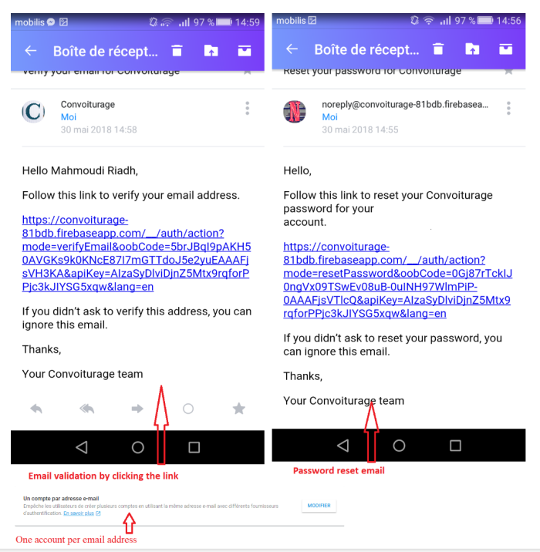
security & coherence
Sucerity methods:
Validation and verifications processes while registering users in our system, for essential user information like Emails passwords and phone numbers by sending users a verification Emails to verify if they are the real owners of those emails. In addition, a validation code pins is sent to them in order to validate their phone numbers.
Authentication system with emails and password to allow users access their sessions securely.
One account per email address, Prevents users from creating multiple accounts by using the same email address with different authentication providers.

Slide 21
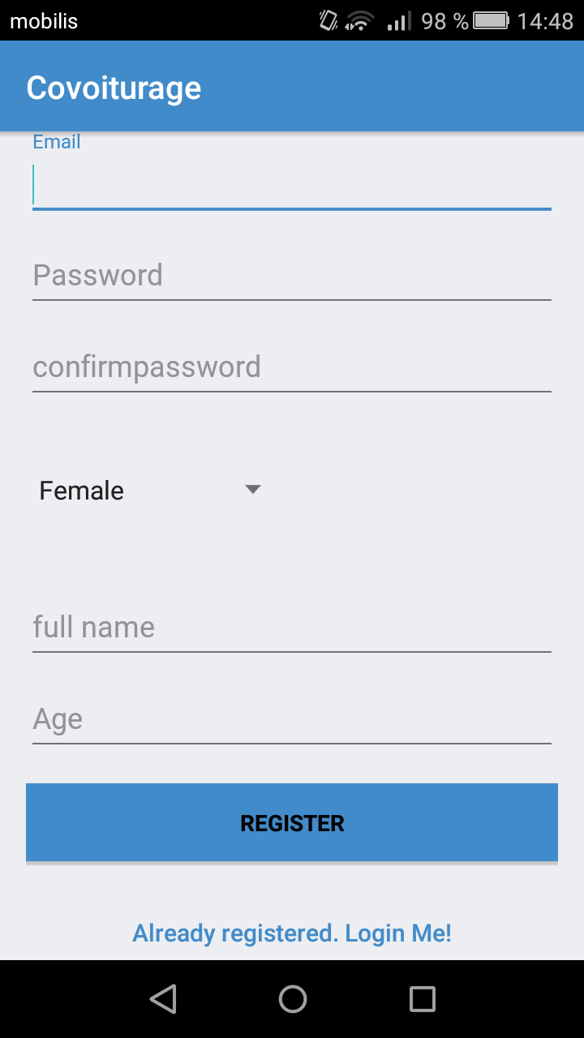
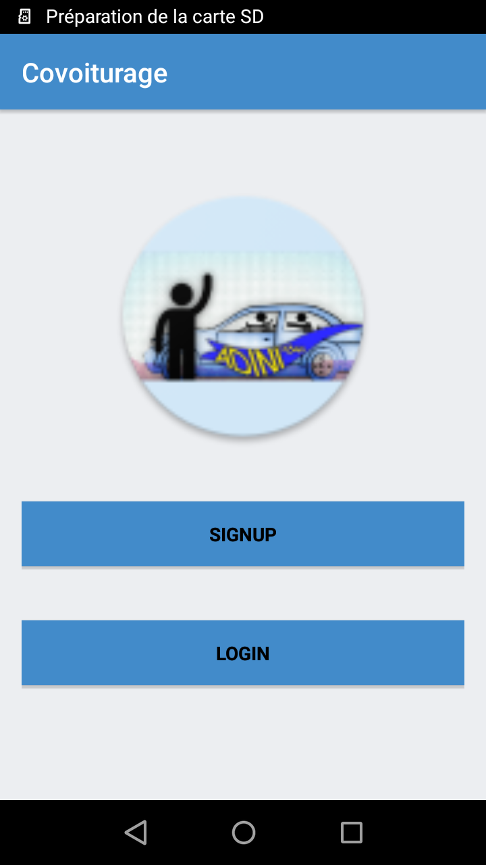
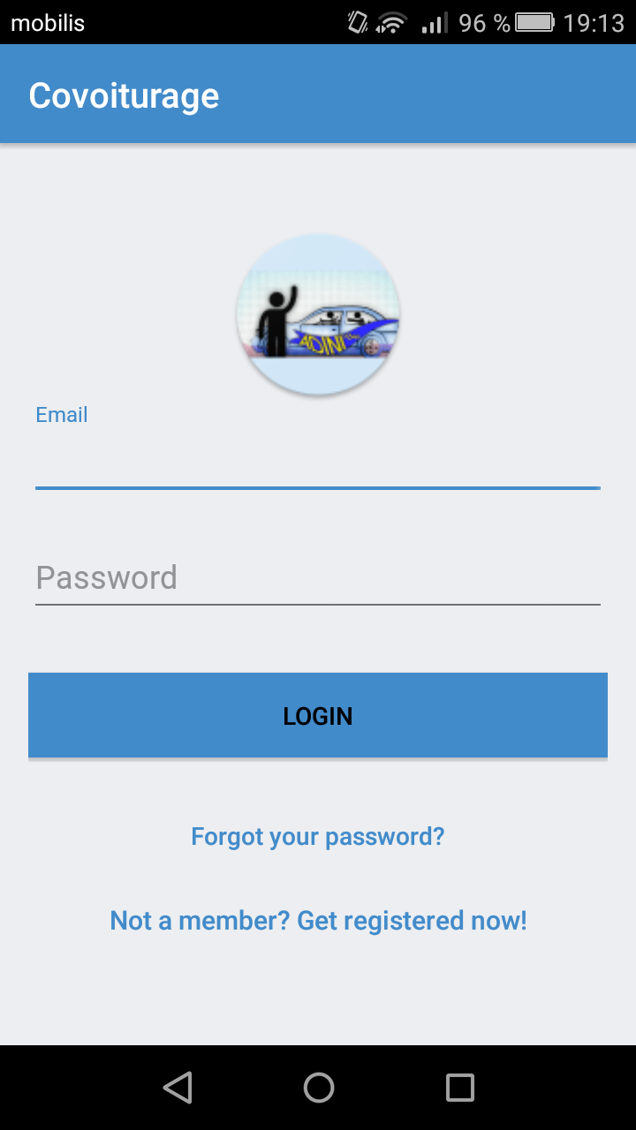
security & coherence
User interface
L’interface utilisateur

Slide 22
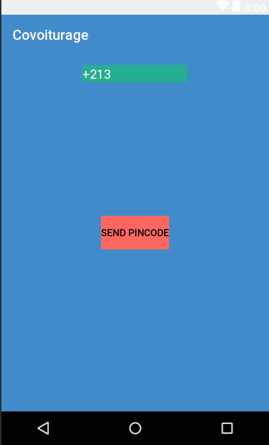
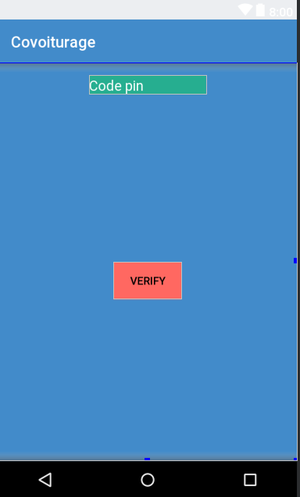
security & coherence
User interface
After registration and for security reasons, we send an email confirmation and PIN code to the user phone number to validate his phone number.
Confirmation with PIN code

Slide 23
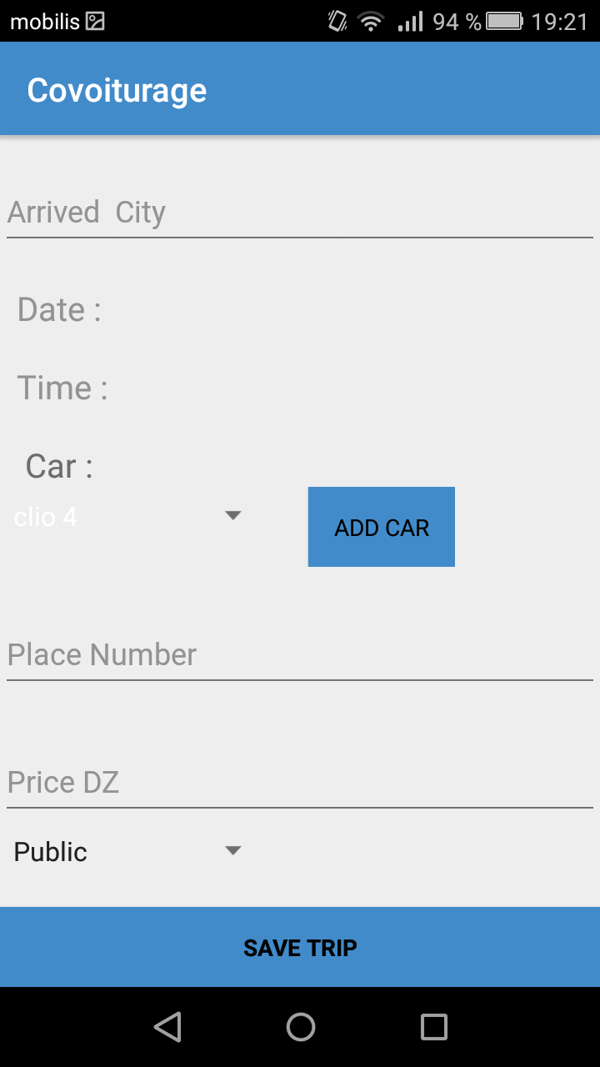
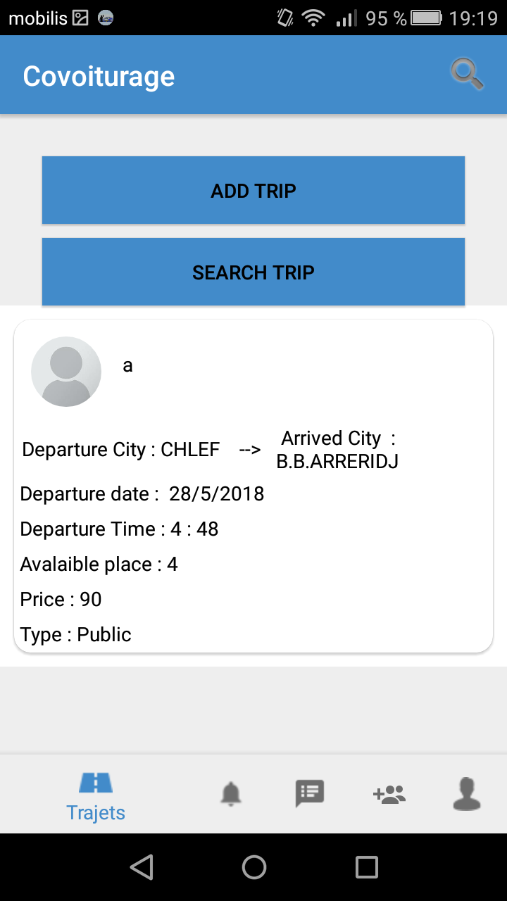
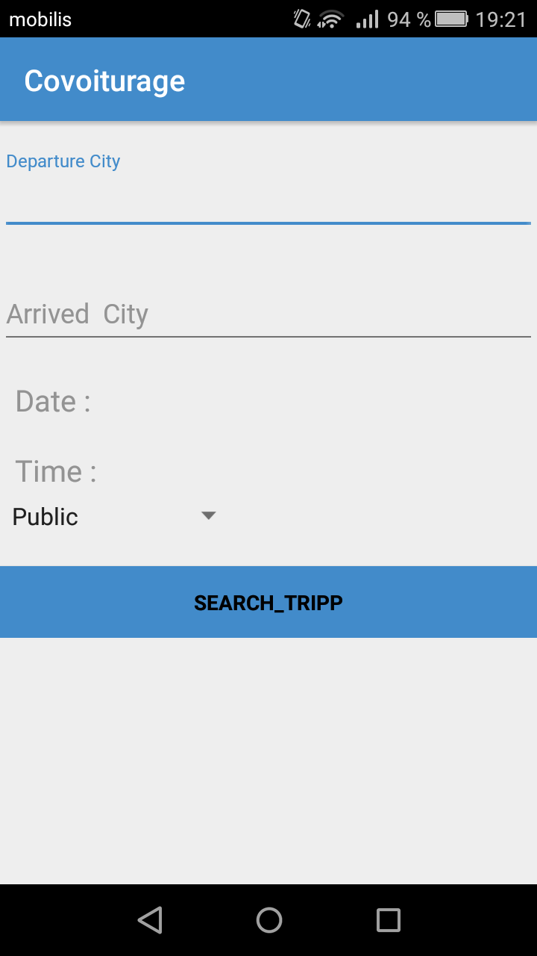
security & coherence
User interface
Home screen

Slide 24


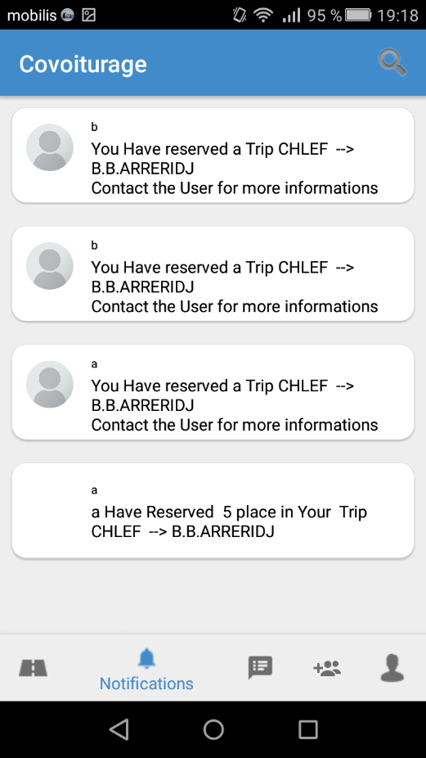
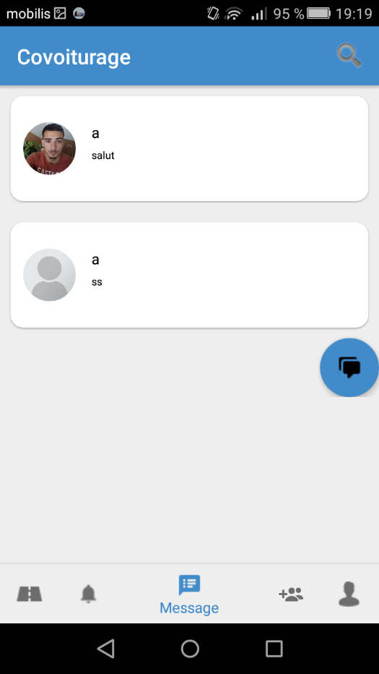

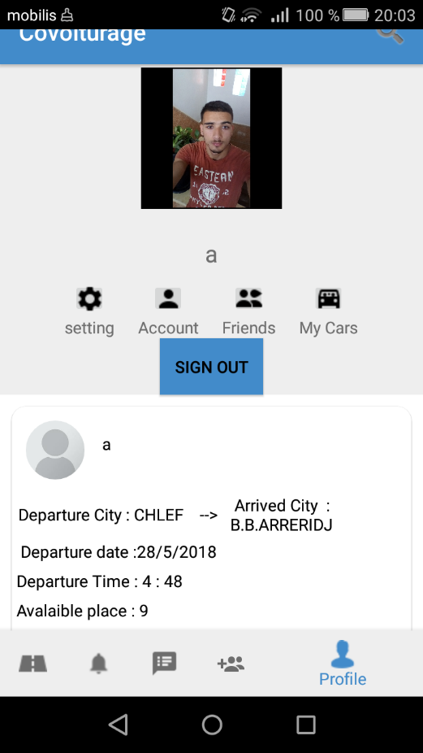
security & coherence
User interface

Slide 25

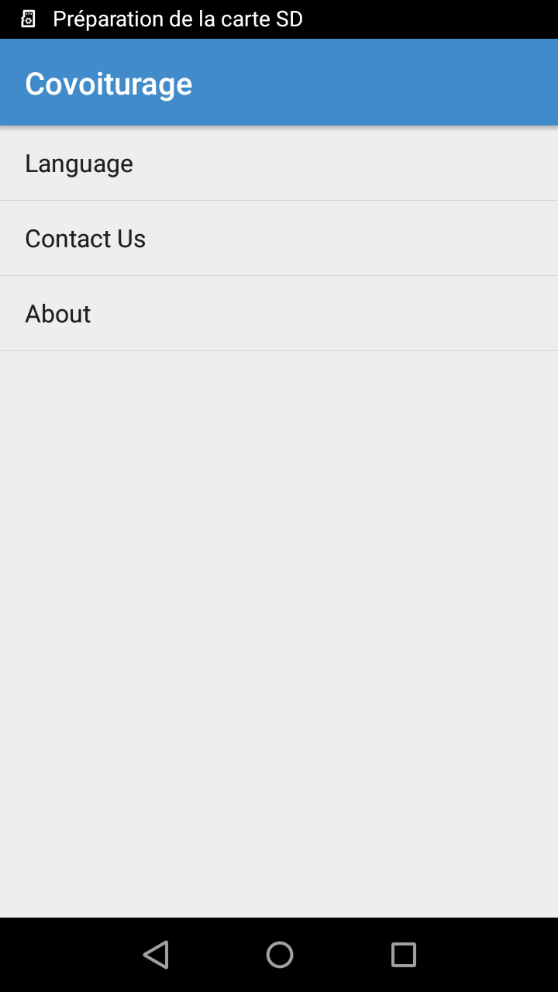
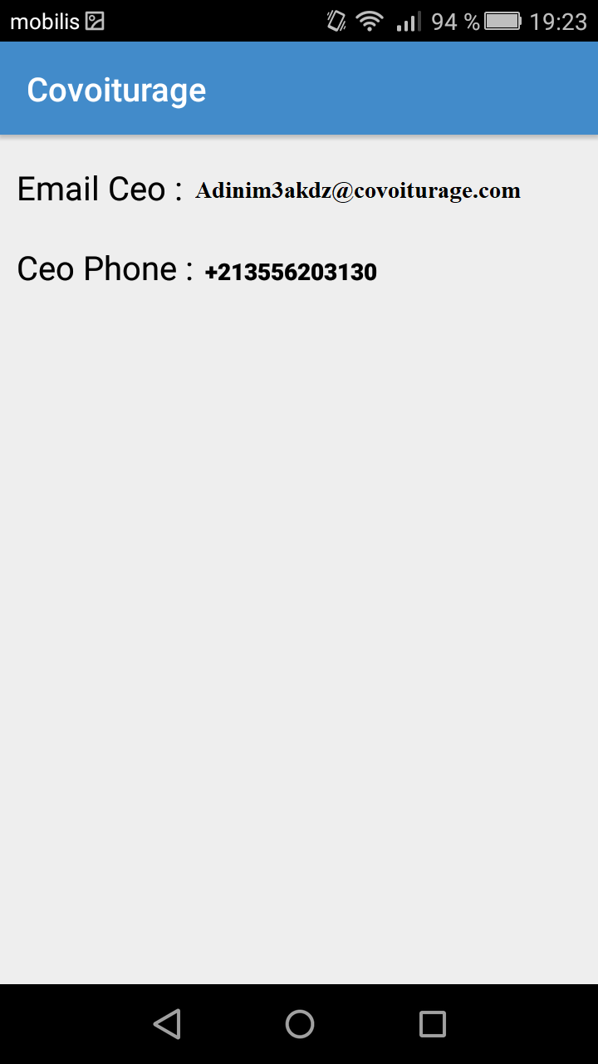
security & coherence
User interface
Options and fonctionalities in the user profile

Slide 26
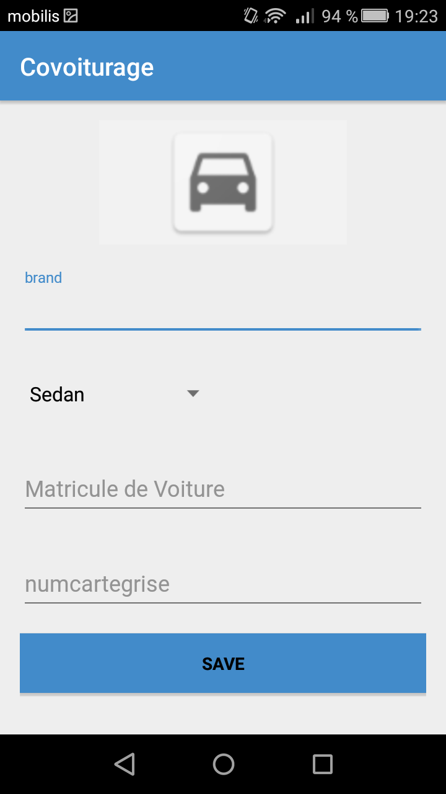
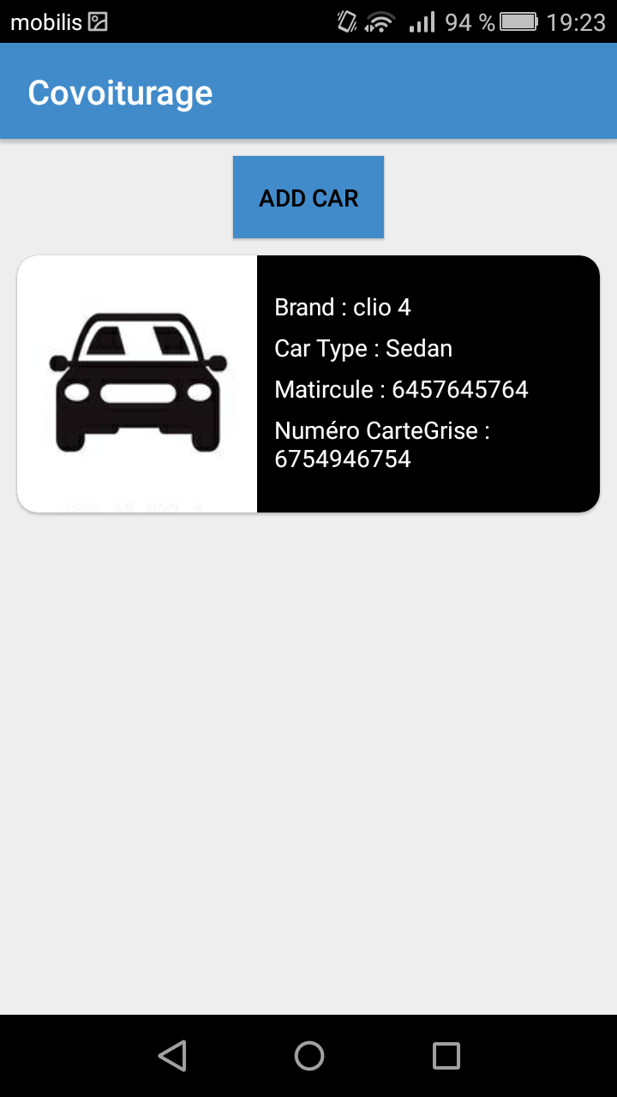
security & coherence
User interface
My cars : It is to add the information of cars used by users

Slide 27
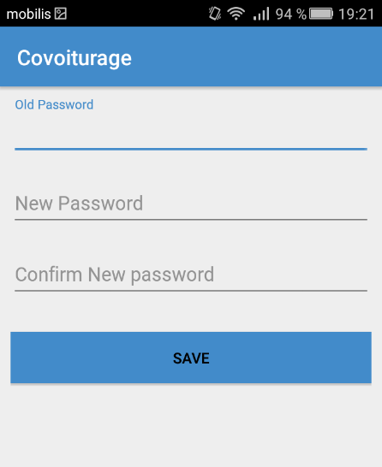
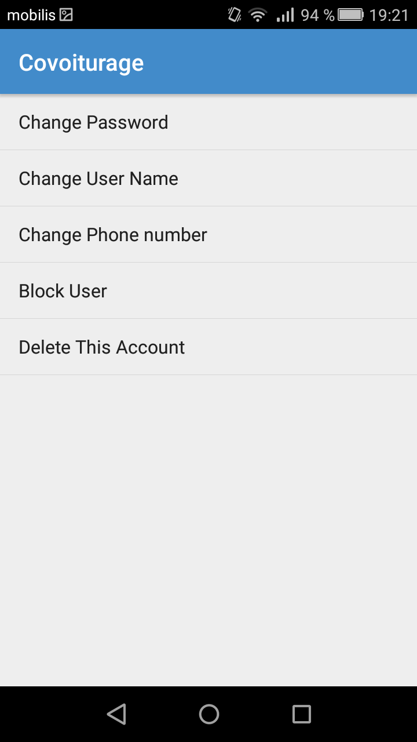
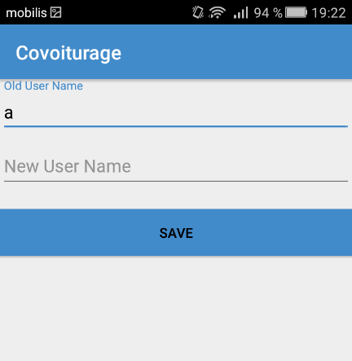
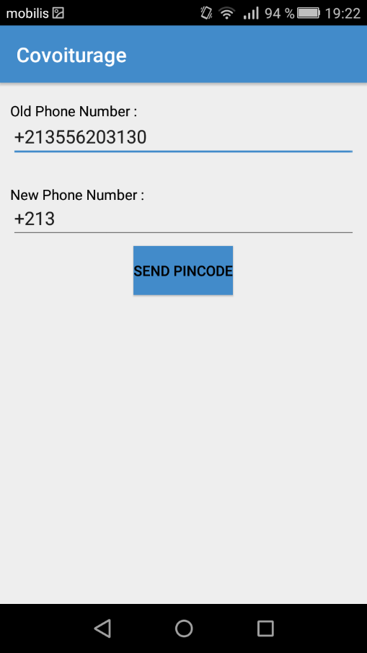
security & coherence
User interface

Slide 28
Used tools

Slide 29


Application development tools
IDE : Integrated development environment
Data base
Android Studio is the official Integrated Development Environment (IDE) for Android app development, based on IntelliJ IDEA .
The Firebase Realtime Database is a cloud-hosted database.
Data is stored as JSON and synchronized in realtime to every connected client

Slide 30
We hope it will be the best alternative solution for public transports problem

Slide 31
The end
Thank you for your attention

